Slide 1
SIC/XE Assembler
High Definition SIC (Hameed Devan Samuel)

Slide 2
What we did
In simple terms, we wrote code.
  One of us did 500 lines in a few hours because another one of us thought it was due the 29th.
In more complex terms:
  Used Hameed’s Pass 1/2 as a baseline.
  Updated the Pass 1 to reflect SIC/XE standards
  Implemented Floating Point
  Added support for new SIC/XE instructions, formats, and modes.

Slide 3
SIC/XE Functionality: Samuel Mikell
Adding New Instructions
Updating memory max
Fixing a header problem
  headers.h did not have all of the function signatures from symbols.c, resulting in conflicting and missing signatures. symbols.c was also being included in main.c
  Solution: add missing signatures, remove the include, enjoy clean compile.

Slide 4
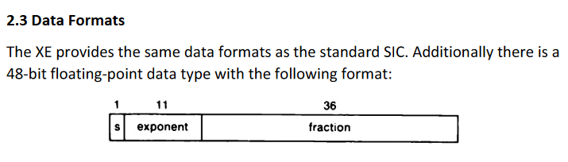
SIC/XE Functionality: Devan McCarthy
Floating Point Format
Steps for calculating hex:
Set s bit to 1 if the number is negative
Turn the whole number and decimal number into binary
Move the decimal left or right to put it into scientific notation
Add or subtract the exponent from 1023 and add to the exponent section
Take the numbers to the right of the decimal and add them to the fraction section

Slide 5
SIC/XE Functionality: Hameed Sholji
A.K.A. The chunk of Pass 2
Implemented the new instruction formats
Added supported for the various addressing modes
Updated object code writing

Slide 6
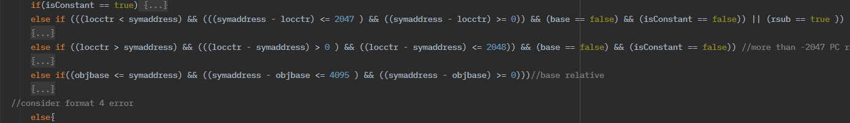
Difficulties faced implementing the SIC/XE in Pass 2
  Implementing a way to determine whether the symbol uses base or PC addressing.
    Resolved via if statements and booleans to find whether we could actually use the specified mode or not (due to BASE/NOBASE instructions).
  Determining how to find #, @, or + in a symbol.
    Easily done, just find the first letter of each word in the assembly line, and check for #, @, or +.
  Printing a negative number to the object code to implement negative addressing
    Had to implement via bitwise not + 1
    Bitwise and with 0x0000FFF gave us the correct two’s complement negative number.
  Calculating the floating point in base 10
    This was done to make it easier to implement by just printing the long using %x for the object code.

Slide 7
Limitations
Not enough available SIC/XE object code, hard to check ourselves except from the SCOFF SICXE output.
Assumes every file it reads is a SIC/XE file.

